Slide 1


COLLEGE MANAGEMENT SYSTEM
Presenting by
1.N.Sasirekha
2.T.Sravanthi
Guided by
Mrs.Pavithra

Slide 2
INTRODUCTION:
The College management system is an automated version of manual Student Management System.
It can handle all details about a student.
In case of manual system they need a lot of time, manpower etc.Here almost all work is computerized. So the accuracy is maintained. Maintaining backup is very easy. It can do with in a few minutes.
Our system has two type of accessing modes, administrator and user. Student management system is managed by an administrator. It is the job of the administrator to insert update and monitor the whole process.

Slide 3
DRAWBACKS OF MANUAL COLLEGE MANAGEMENT SYSTEM
This process is so time-consuming.
There is a threat to the record of the student and teachers, in this case, there might be a chance that a person makes entry on someone else record.
There is no proper way of getting to know about the events and extra curriculum activities happening in colleges.
It might be the case that student tries to bribe the teachers to avoid the long queue.

Slide 4
APPLICATION OF AUTOMATED COLLEGE MANAGEMENT SYSTEM
A student can register himself directly on the college application for any notification of the event and for depositing fee and students can also post their queries and check their fee status.
If the students are not aware of policies, then the admin will make him contact with this application and help them to complete the whole process.
Admin will maintain the record and atomicity by using the proper table to save records so that no one can access it and data remain safe.
Students need not bother about his/her fee deposit and without moving from their place or making so many phone calls they can make the fee payment.
No need of worrying about status you can check that from your place

Slide 5
MODULES
Admin Module
Professor Module
Student Module
Course Module
Payment Module

Slide 6
SOFTWARE REQUIREMENTS
BACKEND:
Spring Core, Spring Boot,Rest API, Java Persistence API and Hibernate
Postman
DATABASE:
MySql

Slide 7
HARDWARE REQUIREMENTS
Windows 10 are above.
RAM 4GB or above.

Slide 8
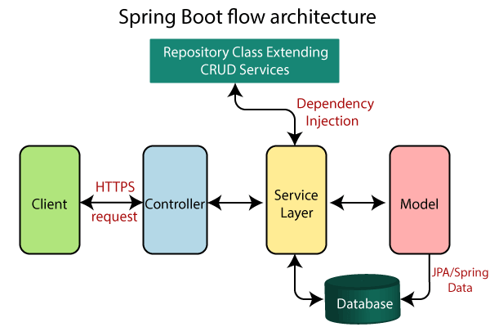
WHAT IS SPRING BOOT?
Java Spring Boot(Spring Boot) is a tool that makes developing web application and microservices with Spring Framework faster and easier through three core capabilities
Auto Configuration
2. An Opinionated approach to Configuration
3.The ability to create standalone
applications

Slide 9
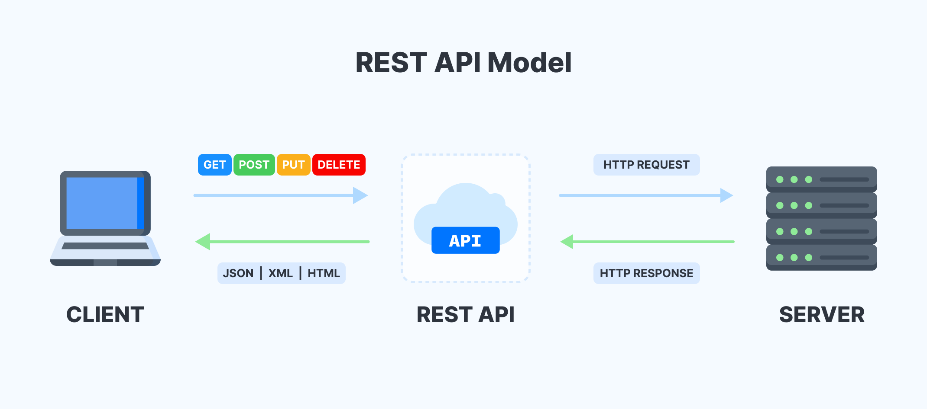
What is Rest API?
Representational State Transfer (REST) is an architectural style that defines a set of constraints to be used for creating web services.
REST API is a way of accessing web services in a simple and flexible way without having any processing.

Slide 10
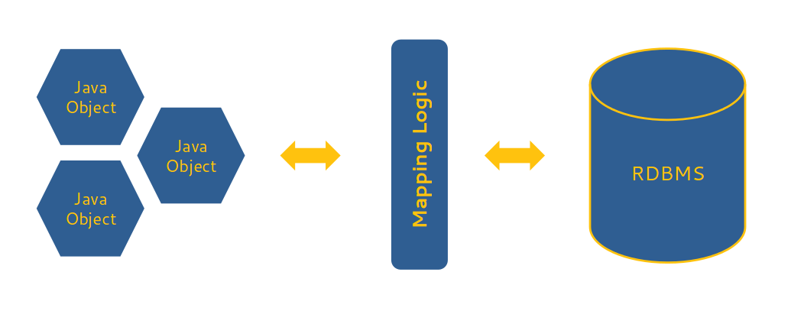
Java Persistence API ?
A JPA (Java Persistence API) is a specification of Java which is used to access, manage, and persist data between Java object and relational database.
It is considered as a standard approach for Object Relational Mapping.
JPA can be seen as a bridge between object-oriented domain models and relational database systems.

Slide 11
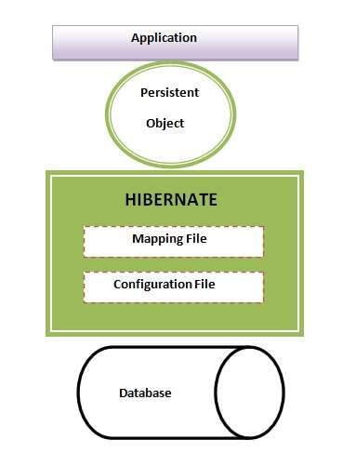
Hibernate ?
Hibernate is an Object-Relational Mapping (ORM) tool which is used to save the state of Java object into the database.
It is one of the most frequently used JPA implementation.
It is defined in org.hibernate package.

Slide 12
POSTMAN?
Postman is an application used for API testing.
It is an HTTP client that tests HTTP requests, utilizing a graphical user interface, through which we obtain different types of responses that need to be subsequently validated.
Postman is an application that allows us to test APIs utilizing a graphical user interface.

Slide 13
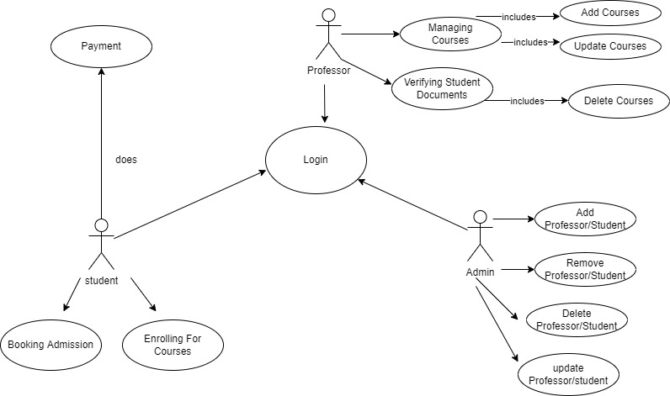
USE CASE DIAGRAM:

Slide 14
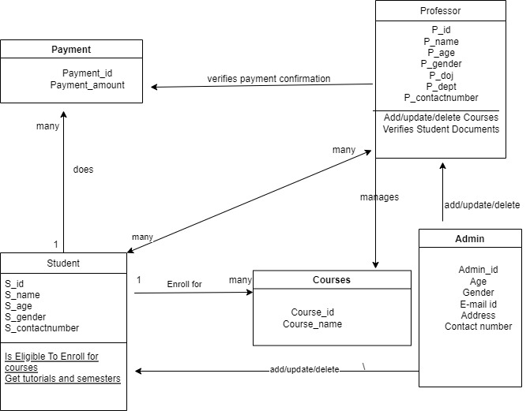
CLASS DIAGRAM:

Slide 15
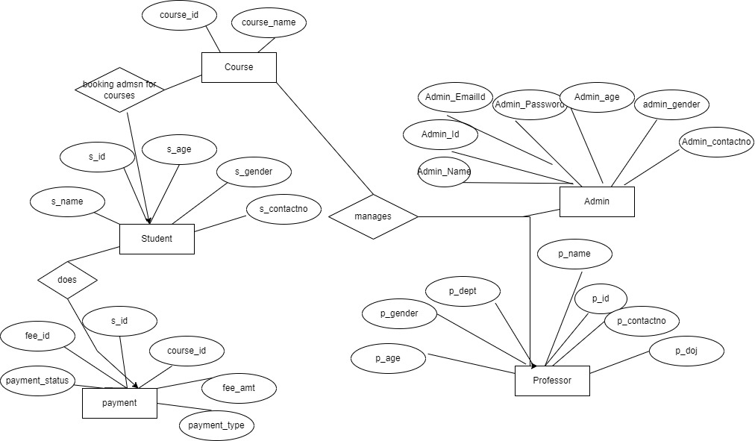
ER DIAGRAM

Slide 16
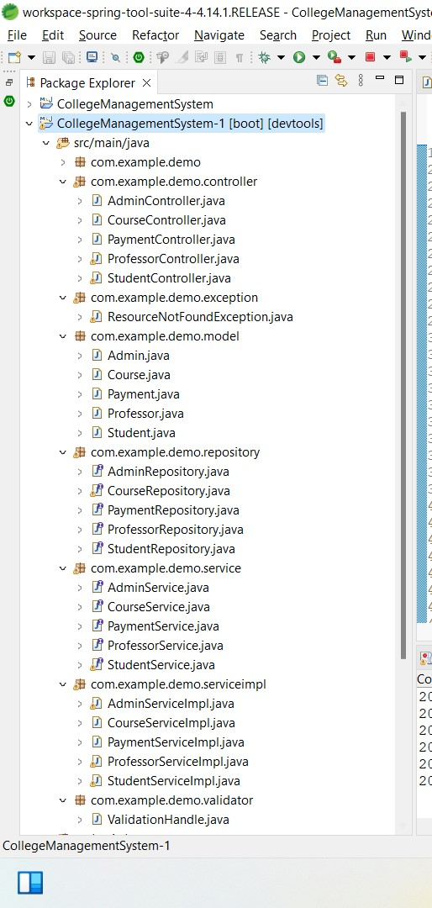

Slide 17
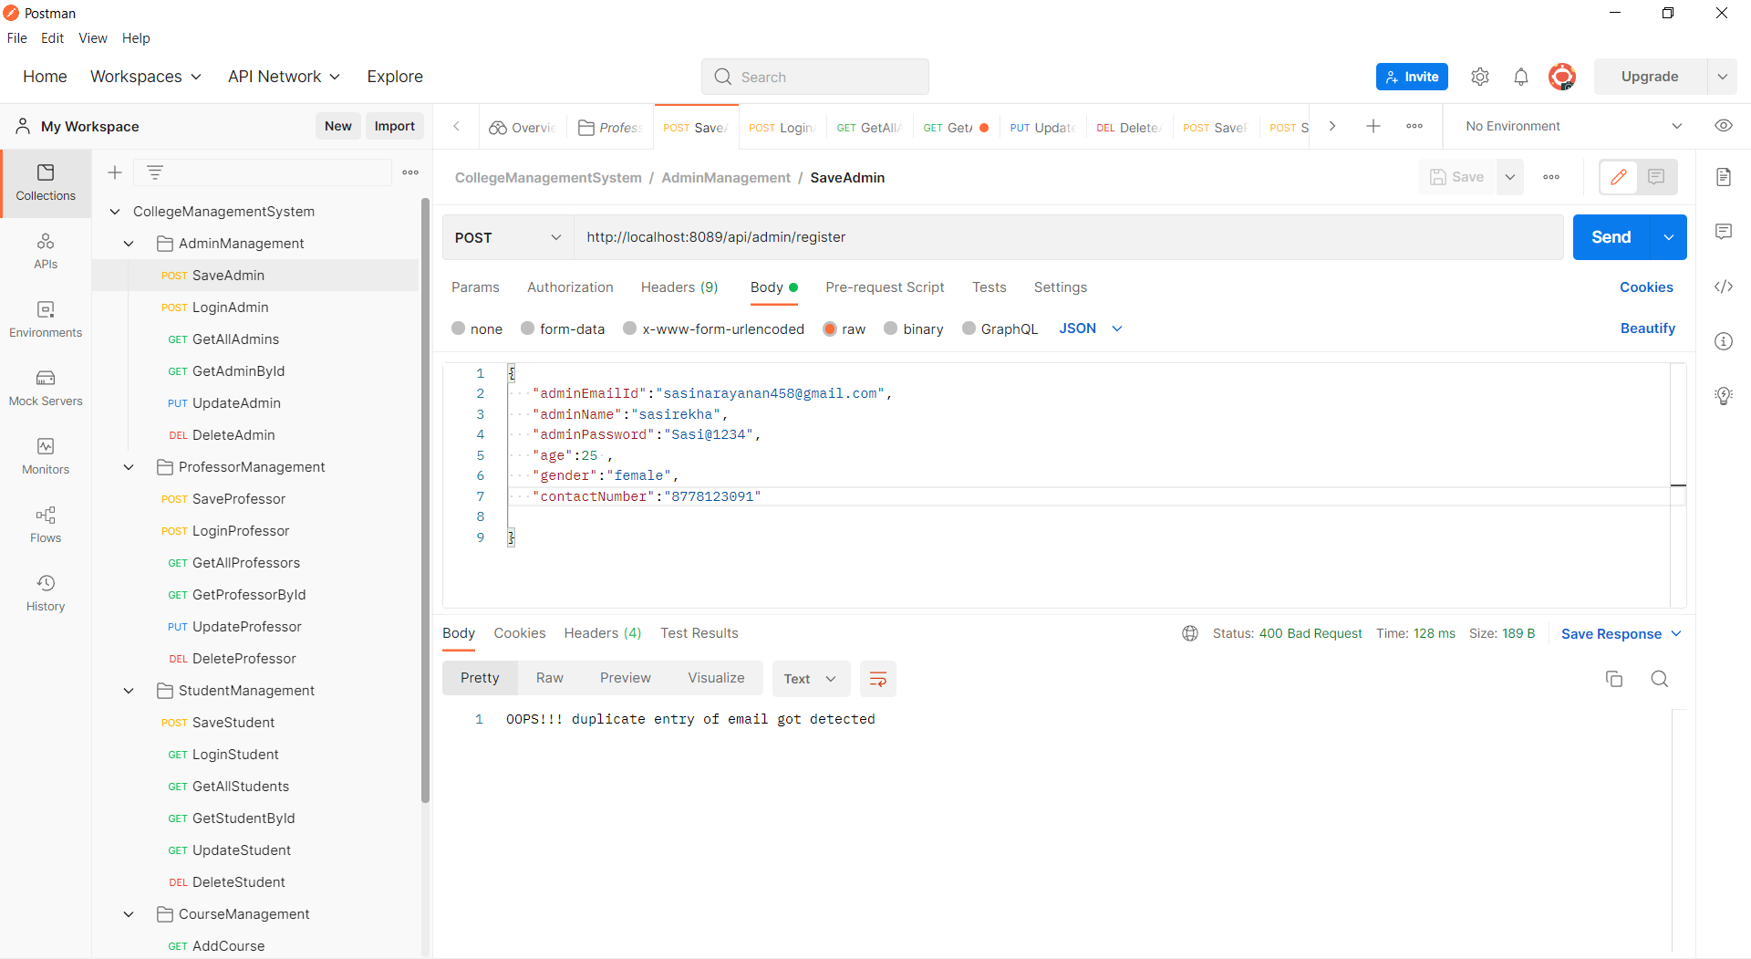
OUTPUT SNAPSHOT-1

Slide 18
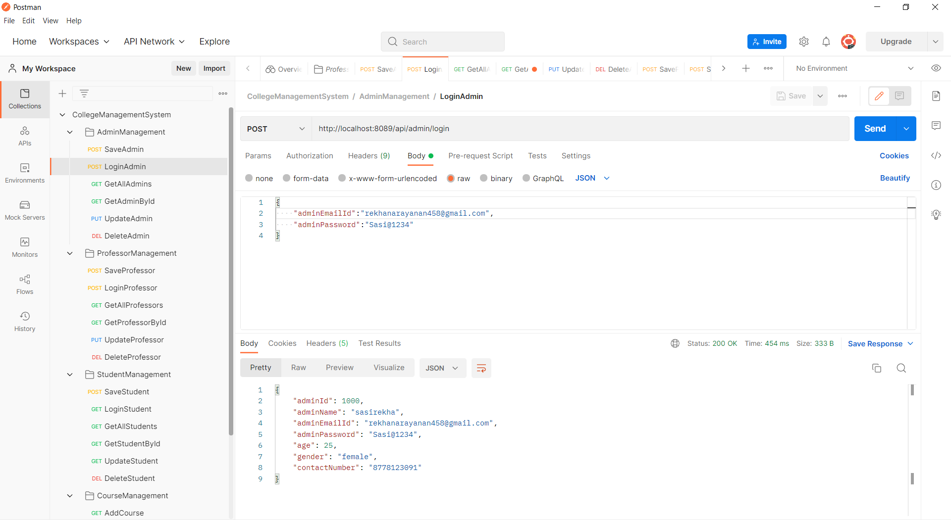
OUTPUT SNAPSHOT-2

Slide 19
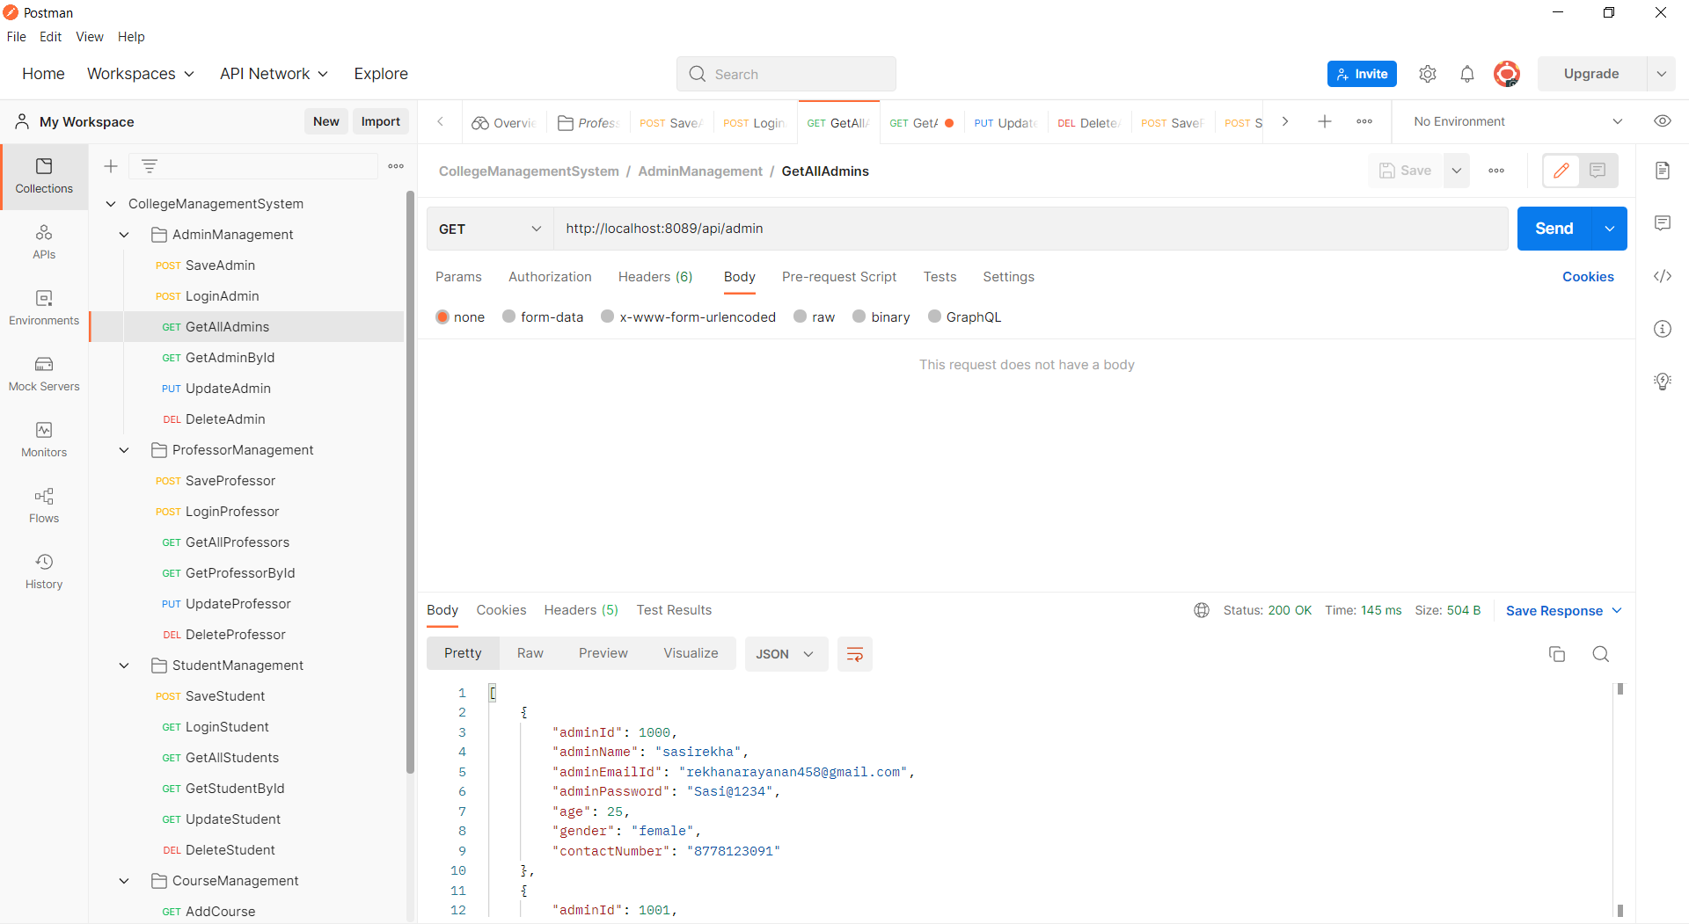
OUTPUT SNAPSHOT-3

Slide 20
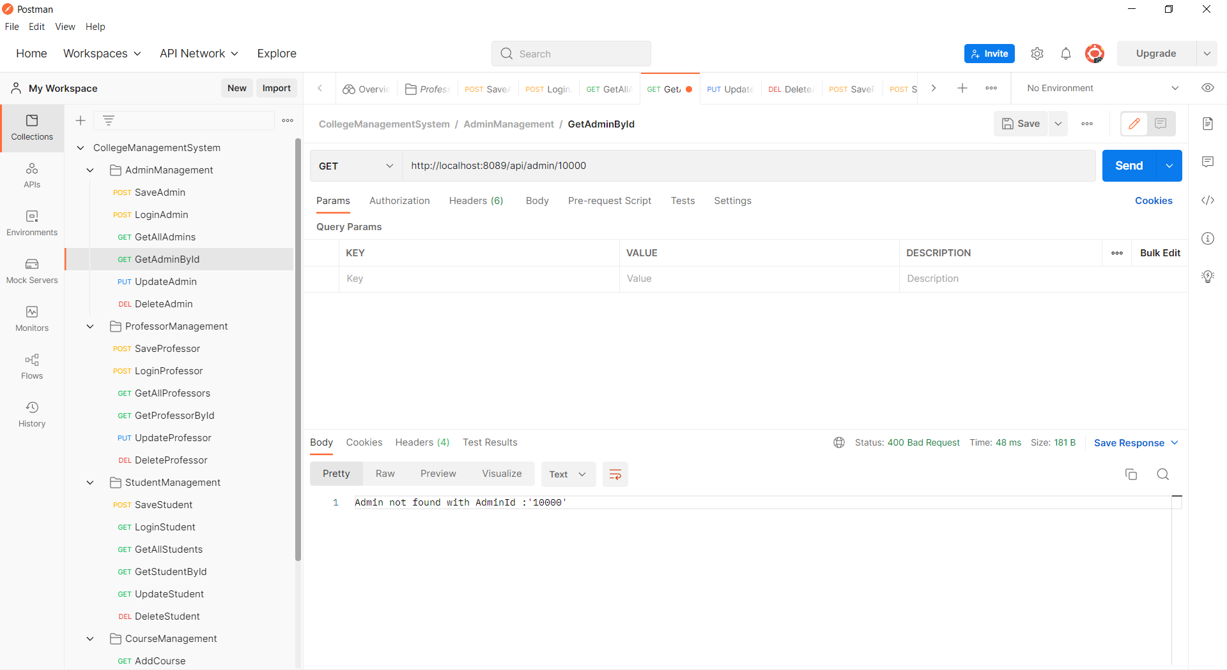
OUTPUT SNAPSHOT-4

Slide 21
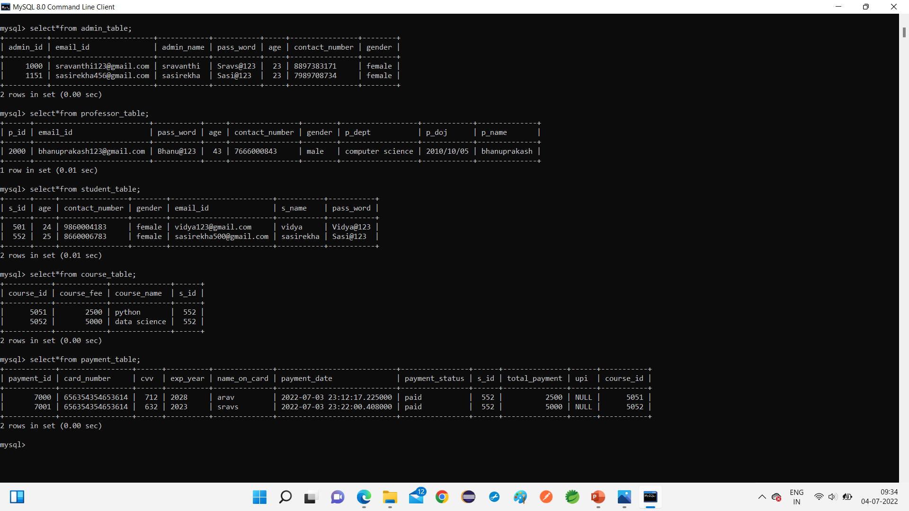
OUTPUT SNAPSHOT-5

Slide 22
FUTURE SCOPE
We can enhance this system by including more features like online examination module to conduct online examination.
Further,The Faculty can upload the study materials of their lectures on this site and students who had missed those classes can view those study materials for better understanding.

Slide 23
CONCLUSION
This paper presents a method for increasing information requested by students with the use of automated College Management System.In this ,instead of direct Contacting with faculty the student can directly checks the Courses and Fees Details from the System if the student is registered in CMS.
CMS helps educational institute to do regular activities accurately, fastly and reliably.
THANK YOU!!

Slide 24
REFERENCE
https://www.w3schools.com/java/
https://www.javatpoint.com/spring-boot-tutorial

